Slide 1
Latin America: Revolution and Reaction to the 21st Century

Slide 2
Intro
Latin America was pulled into the struggle between the capitalist West and Communism
Salvador Allende
Socialist President of Chile
Overthrown by General Augusto Pinochet
Established an Authoritarian regime
Arrested for crimes against humanity
Fidel Castro
Communist leader in Cuba

Slide 3
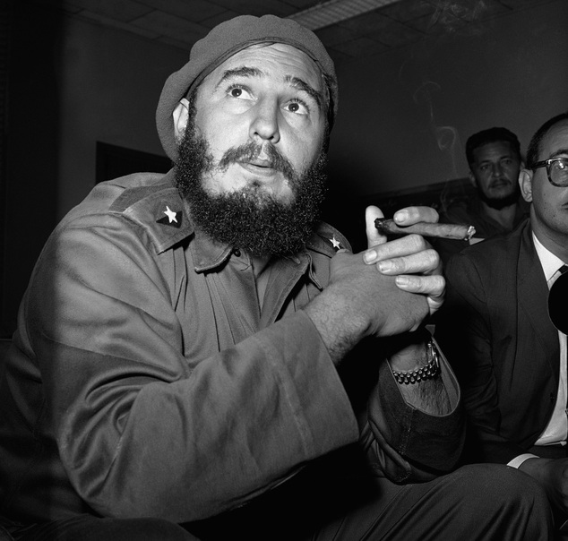
Allande & Castro

Slide 4
Intro
Third World
Developing nations outside of capitalist industrial nations (First World) and Industrialized Communist nations (Second World)
Faced issues of economic development & radical revolutions

Slide 5
Latin America after WWII
Most Latin American countries were still dominated by authoritarian reformers
Vargas in Brazil
Populist nationalism
Peron in Argentina
Populism and political repression

Slide 6
Latin America after WWII
I. Mexico and the PRI
Party of the Institutionalized Revolution (PRI) controlled Mexico from the 1940’s until 2000
Corrupt
Lacked social reform
Zapatistas
Guerrilla army that invaded Chiapas
PRI responded with repression and negotiation

Slide 7
Zapatistas

Slide 8
Latin America after WWII
North American Free Trade Association (NAFTA)
Ties Mexico to US economics and politics
Mexico became the 2nd largest trade partner with the US
Election of 2000
PRI voted out
National Action Party (PAN) in
Wanted to clean up corruption and improve conditions of workers in the US

Slide 9
Radical Options in the 1950’s
Pressure for change built up in most of Latin America in the 1940’s
Desire to improve social and economic conditions
Believed development and economic strength were the key to success
Mexico = one-party rule continues
Venezuela and Costa Rica = democracies
Bolivia = mix of radicalism & reaction

Slide 10
Radical Options in the 1950’s
II. Guatemala: Reform and US Intervention
Economic disparity
High mortality rates & poor health conditions
Illiteracy
Coffee & Banana’s main exports

Slide 11
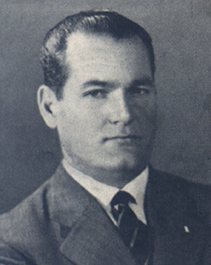
Radical Options in the 1950’s
Juan Jose Arevalo
Elected President of Guatamala in 1944 by the labor coalition
“spiritual socialism”
Land reform & improvement of working conditions
Used intense nationalism

Slide 12
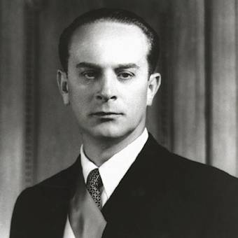
Radical Options in the 1950’s
Colonel Jacobo Arbenz elected in 1951
More radical land reform
Threatens to take away land from the United Fruit Company (foreign interest)
Led to US intervention
CIA helps US overthrow Arbenz
Pro-American regime takes over
Reform in Guatemala ends due to
internal and foreign opposition

Slide 13
Radical Options of the 1950’s
III. The Cuban Revolution: Socialism in the Caribbean
Large middle-class in Havana
Higher literacy rates
Better health conditions
Export sugar and tobacco
Heavy American influence
¾ of imports came from the US
American investments in Cuba

Slide 14
Radical Options of the 1950’s
Fulgencio Batista
Authoritarian ruler from 1934 – 1944; 1952
Democratic constitution of 1940
Nationalization of natural resources
Full employment
Land reform
Corrupt government
Opposition develops

Slide 16
Fuglencio Batista

Slide 17
Radical Options of the 1950’s
Fidel Castro
Attempted revolution, but failed
Revolutionary ideals included:
Democracy
Social Justice
Establishment of a less dependent economy
Exiled to Mexico and aided by Ernesto “Che” Guevara

Slide 18
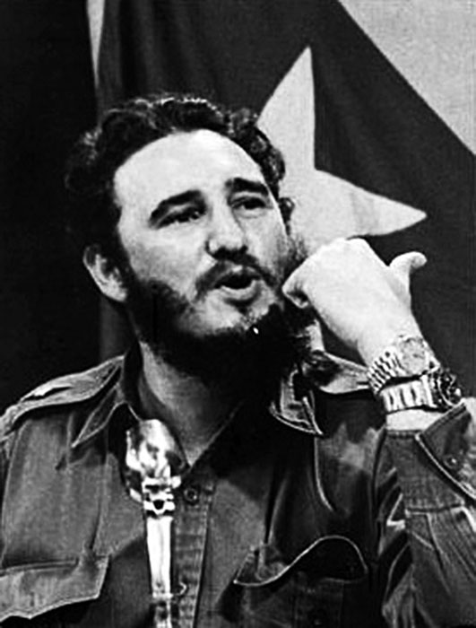
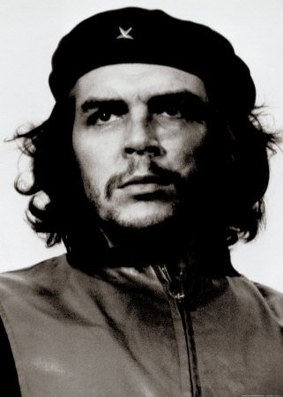
Castro & Guevara

Slide 19
Guevara & Castro

Slide 20
Radical Options of the 1950’s
26th of July Movement
Castro and Guevara supported by students, labor organizations, and rural workers
Drive Batista from power in 1958
Castro takes power
Implements a socialist regime
Collectivization
Expropriation of foreign property
Centralized socialist economy
Nationalism and anti-imperialism

Slide 21
Radical Options of the 1950’s
Relations between Cuba & US broken off in 1961
Trade embargo implemented (trade not allowed)
Cuba depends on USSR for financial aid and arms
Cuban Missile Crisis 1961
The Cuban Revolution survived due to the global context
Social reforms were extensive, but basic freedoms were lost
Cuba’s economy survived due to subsidies by the USSR

Slide 24
The Search for Reform and the Military Option
Latin America continued to seek solutions to their problems using Catholic, Marxist, and Capitalist doctrines
Mexico – Political Stability
One-party system
Repression
Petroleum resources
Poor financial planning, corruption, and foreign debt caused problems in the 80’s

Slide 25
The Search for Reform and the Military Option
Chile & Venezuela – Christian Democracies
The church was divided politically
Arguments for social justice and human rights
Some supported government opposition of the church
Brazil & El Salvador - Liberation theology
Combined Catholic theology and socialist principals/Marxist categories

Slide 26
The Search for Reform and the Military Option
I. Out of the Barracks: Soldiers Take Power
Latin American military establishments began to take over governments in the 1960’s
Brazil
Military takes over in 1964
Aided by the US
Argentina
Military coup overthrows Peron in 1966
Chile
Military overthrows Allende (socialist) in 1973

Slide 27
The Search for Reform and the Military Option
Conditions under military leaders:
Bureaucratic authoritarian regimes
Military-like chain of command
Repression and torture used to silence critics
“dirty war”
Working class hit hard
Inequality becomes more apparent
Structural problems
Increase in literacy & health
Nationalism

Slide 28
The Search for Reform and the Military Option
II. The New Democratic Trends
Cold War pressures ease in the 1980’s
Redemocratization
Argentina holds elections in 1983
Brazil chose its first popularly elected President in 1989
Sendero Luminosos tries to disrupt elections in 1992

Slide 29
The Search for Reform and the Military Option
Nicaragua removed the Sandinista Party under threat of embargo
Nicaragua, El Salvador, and Guatemala have truces between governments and rebels
Panama is invaded by the US to arrest Manueal Noriega

Slide 30
Maneul Norigea

Slide 31
The Search for Reform and the Military Option
The 1990’s saw democratic trends being well established
Hugo Chavez – Venezuela
Survived a coup in 2002
Had strong support of other military leaders

Slide 32
Hugo Chavez

Slide 33
The Search for Reform and the Military Option
Latin American Economies
Many countries faced economic crisis due to
Foreign debt
Inflation
Social instability
Drug Commerce
Tremendous profits
Criminal activity
International cartels
Cuba, Columbia, Panama, & Bolivia

Slide 34
The Search for Reform and the Military Option
III. The US and Latin America
The US remained a continuous presence in Latin America
US becomes the leading investor
More than 1/3 of US investments went to Latin America
US military intervenes more than 30 times before 1933
Haiti, Nicaragua, Dominican Republic, Mexico, & Cuba

Slide 35
The Search for Reform and the Military Option
Interventions were for economic, political, strategical, and ideological reasons
Helped in creating Banana Republics = conservative and/or dictatorships friendly with US
Good Neighbor Policy 1933
FDR
Promised the US would be more fair with Latin America and stop direct interventions

Slide 36
The Search for Reform and the Military Option
Cold War effects
New & indirect involvement
Alliance for Progress 1961
Alternative to radical solutions
President Jimmy Carter (1976-1980)
Pragmatic dealings with Latin America
Observance of Civil Liberties
Treaty with Panama

Slide 37
The Search for Reform and the Military Option
Reagan & Bush 1980’s
Conservative presidencies based on economic, strategic, and defense
Direct interventions or support of counterrevolutionary forces
Contras in Nicaragua
Post 2000 issue with Latin America include immigration, commerce, drug trade and political stability

Slide 38
Societies in Search of Change
Social relations changed slowly in Latin America
Population growth, urbanization, and migration of workers are challenges to the region

Slide 39
Societies in Search of Change
I. Slow Change in Women’s Roles
Suffrage rights
Ecuador 1929
Brazil and Cuba 1932
More countries followed suit in the 1940’s and 1950’s
Many feared women in politics would become a conservative force

Slide 40
Societies in Search of Change
Feminist organization, suffrage movements, and international pressures eventually combined to bring about change
The right to vote did not guarantee political rights
Women did not have equal pay in Latin America
Many join labor unions and organizations
80% of textile workers in Argentina were women

Slide 41
Societies in Search of Change
By the mid-1990’s, women’s positions in Latin America were close to that of Western society

Slide 42
Societies in Search of Change
II. The Movement of People
Mortality rates decline
Fertility rates increased
Extralegal immigration increased after WWII
750,000 illegals crossing the border to US by the 1970’s in search of work
Conditions for migrant workers were deplorable

Slide 43
Societies in Search of Change
Politics influenced migration
Cuban Revolution
Nicaraguan Revolution
Haitians fleeing political repression and bad living conditions
Some migration occurred within Latin America
Rural to urban areas due to a move from agrarian to industrial work
Rapid urbanization led to favelas

