Slide 1
Facism
The Authoritarian Response

Slide 2
The Authoritarian Response
I. The Rise of Nazism
The Great Depression and punishments from the Treaty of Versailles led to a fascist regime in Germany
Fascists attacked corruption, weak parliaments, and Western capitalism

Slide 3
The Authoritarian Response
Adolf Hitler
National Socialist Party or Nazi regime
Led by Adolf Hitler
Won power in the 1932 election
Takes power in 1933
Anti-Semitic
Blamed Jews for personal and national misfortunes
Ruled a totalitarian state
Uses direct control over all activities of its subjects
Gestapo – secret police

Slide 4
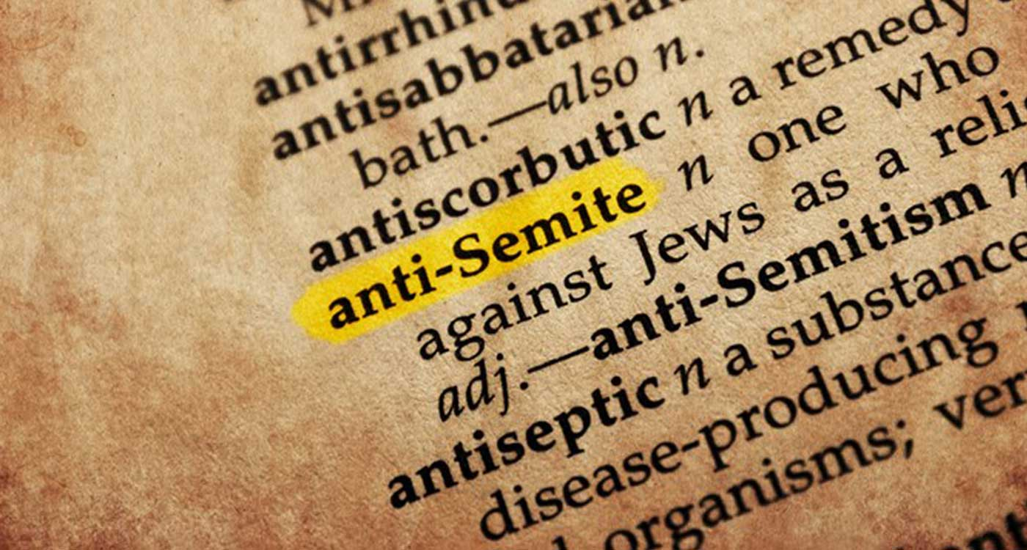
Adolf Hitler

Slide 5
The Authoritarian Response
II. The Spread of Fascism and the Spanish Civil War
Fascist movements in Hungary, Romania, and Austria (Hitler claims Austria)
Italy – Benito Mussolini
Attacked Ethiopia
Condemned by the League of Nations

Slide 6
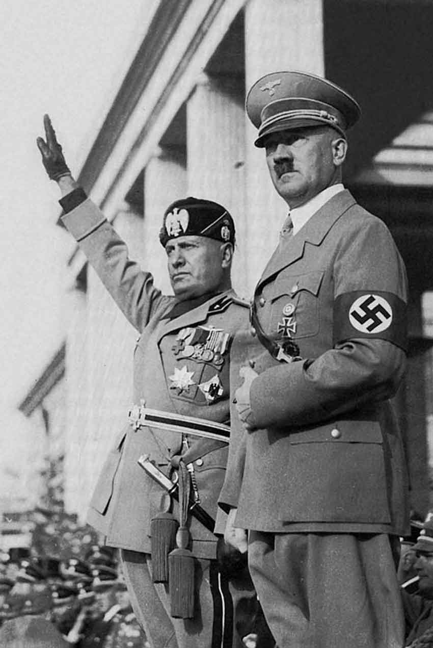
Benito Mussolini

Slide 7
The Authoritarian Response
Spanish Civil War 1936
General Francisco Franco
Backed by the Falange (fascist party), landowners, and the church, Germany, & Italy
Republican forces
Supported by peasants and workers
Communism and Anarchist movements involved too
The Germans and Italians bombed Spain

Slide 8
Francisco Franco

Slide 9
The Authoritarian Response
III. Economic and Political Changes in Latin America
1920’s – 1930’s Liberalism becomes limited
Mostly oligarchies and military power
Communism and socialism spread after the Russian Revolution

Slide 10
The Authoritarian Response
IV. The Great Crash and Latin American Response
Economic dependency and weak liberal regimes affected the economy
Conservatives back corporatism
State mediates interests of diff social groups
Lazaro Cardenas
Mexico
Land reform
Most successful example of new political regime in LA

Slide 11
Lazaro Cardenas

Slide 12
The Authoritarian Response
The Vargas Regime in Brazil
A short civil war started in 1929 and Getulio Vargas emerges as the new president
Vargas promised liberal reforms and to end corruption
1937 a new constitution was implemented based on Mussolini’s Italy
Used authoritarianism, economic reforms, immigration limited, and eliminated opposition

Slide 13
Getulio Vargas

Slide 14
The Authoritarian Response
Joined Allies during WWII, supplied US bases, and sent troops to fight the Axis power in Italy
In return for help they received arms, financial support, and trade advantages
Vargas commits suicide in 1954

Slide 15
The Authoritarian Response
VI. Argentina: Populism, Peron, and the Military
Argentina was a dependent nation
Juan Peron
Used Nationalism & Populism
Supported by lower classes
supported the Axis in WWII

Slide 16
Juan Peron

Slide 17
The Authoritarian Response
VII. The Militarization of Japan
Authoritarian military took over Japan
Nationalism prevelant
General Tojo Hideki led a military coup
Military suspended civilian policies
1937 – Japan goes to war with China
1938 – Japan controls Manchuria, Korea, and Taiwan

Slide 18
Tojo Hideki

Slide 19
The Authoritarian Response
VIII. Stalinism in the Soviet Union
Stalin wanted to make the USSR a fully industrial society
Planned to do it with full state control
No private/individual ownership of producing property

Slide 20
Joseph Stalin

Slide 21
The Authoritarian Response
Stalin’s economic policies included:
Collectivization
Mechanization of agriculture
Five-Year Plans
Industrialization of USSR using factories for metallurgy, mining, and electric power

Slide 22
The Authoritarian Response
IX. Totalitarian Rule
Stalinism instituted new controls over intellectual life.
Socialist realism was dominant in schoools
Science was controlled
No free scientific inquiry
Politburo – executive committee
Used terror tactics

