Slide 1
Western Society and Eastern Europe in the Decades of the Cold War

Slide 2
Intro
Both western & eastern Europe was devastated by WWII
The West did not bounce back to its pre-war dominance
The US & the USSR become the world superpowers
The US becomes a strong presence in world affairs and military expedientures
The Cold War set the framework for developments in the West and eastern Europe

Slide 3
After WWII: A New International Setting for the West
I. Europe & It’s Colonies
WWII left Europe in shambles
Decolonization & the Cold War were two major changes provoked by WWII
Most colonies were abandoned due to hostilities and nationalist resistance

Slide 4
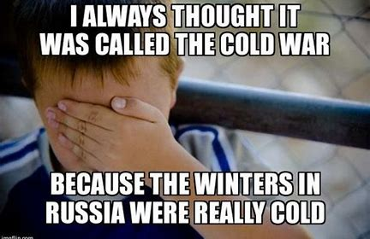
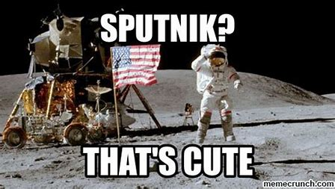

Slide 5
After WWII: A New International Setting for the West
Vietnam
France forced out by Communist guerrillas in 1954
Algeria
Gains independence from France in 1962
Charles de Gaulle
Egypt
Britain and France attack in 1956
Want control of the Suez Canal
US & Russia force them out

Slide 6
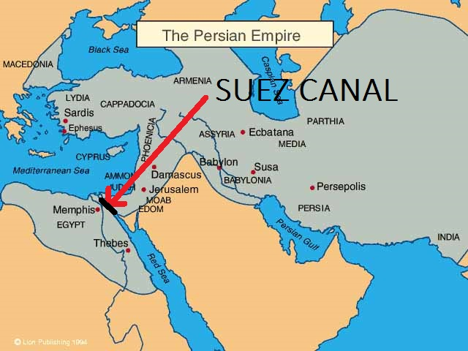
Suez Canal

Slide 7
After WWII: A New International Setting for the West
II. The Cold War
The Eastern Bloc
Czechoslovakia, Bulgaria, Romania, East Germany, and Hungary
All Communist Regimes
No political opposition

Slide 8
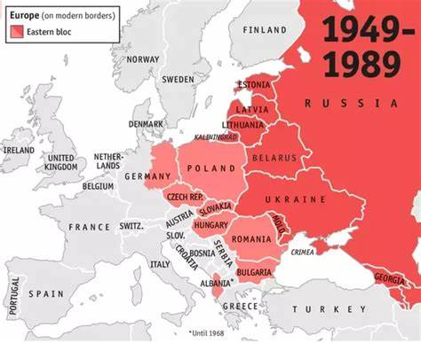
The Eastern Bloc

Slide 9
After WWII: A New International Setting for the West
Harry Truman
“iron curtain” = division between free (democracies) and repressed (Coummunist) societies
The Marshall Plan
Program designed to give loans to Western nations rebuilding after WWII
Seen by Soviets as a way for US economic dominance

Slide 10
After WWII: A New International Setting for the West
Germany becomes the focal point of the Cold War
Germany’s four occupied zones:
Britain, France, US, &USSR
Allies built a unified West Germany in 1946
Russians blockade Berlin in 1947
North Atlantic Treaty Organization (NATO)
Defensive alliance against Soviet aggression
Western Europe, US, and Canada
1949

Slide 11
After WWII: A New International Setting for the West
Warsaw Pact
Soviet version of NATO
Soviets create nuclear capability in 1949
US influences European foreign policy and economics
Cold War shifted outside Europe to Korea, Vietnam, and the Middle East

Slide 12
The Resurgence of Western Europe
I. The Spread of Liberal Democracy
New political movements
Christian Democrats
Blended democracy with social reform
Portugal & Spain
Democratic Constitutions & Parliamentary systems
Federal Republic of Germany (West Germany)
Western Europe becomes politically uniform

Slide 13
The Resurgence of Western Europe
II. The Welfare State
Programs were introduced to reduce the economic inequality in Europe
Includes medical programs
The US adds welfare measures to the New Deal legislation
Medicare

Slide 14
The Resurgence of Western Europe
Welfare states introduce a host of social insurance measures included:
Unemployment insurance
State funded medical care
Family assistance
Housing
Welfare states were expensive
France & Holland = 25% of GNP going to welfare programs
Technocrat – bureaucrats trained in engineering or economics

Slide 15
The Resurgence of Western Europe
III. New Challenges to Political Stability
Student protests 1960’s
Civil Rights Movement
Attacked inequalities and segregation in the Southern US
Vietnam Protests – US
Feminist Movement
Economic and reproductive rights
Green Movement
Environmentalism

Slide 16
The Resurgence of Western Europe
Economic growth slowed in the 1970’s
Recession
New leadership
British Conservative Party
Margaret Thatcher
Longest running Prime Minister
Republican Party
Ronald Regan
Both reduced welfare in their states

Slide 17
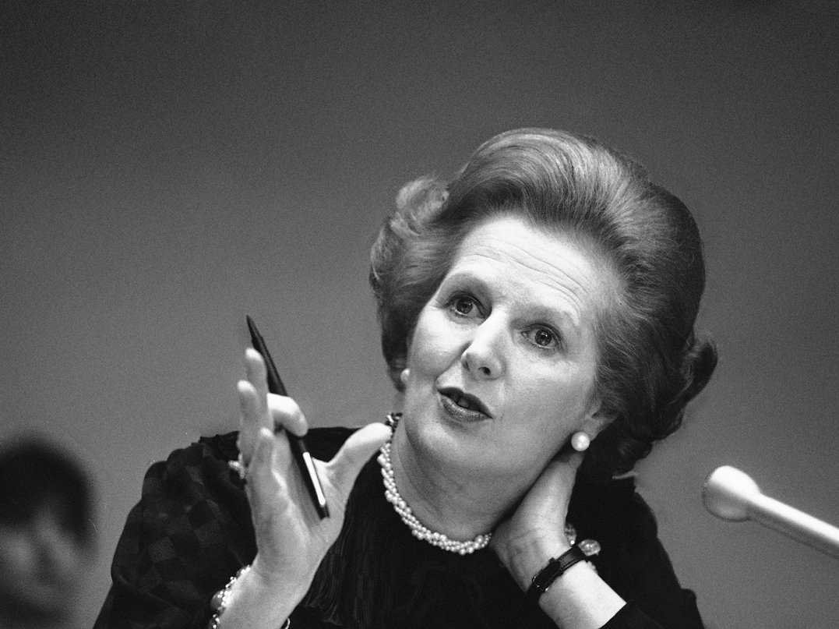
Margaret Thatcher

Slide 18
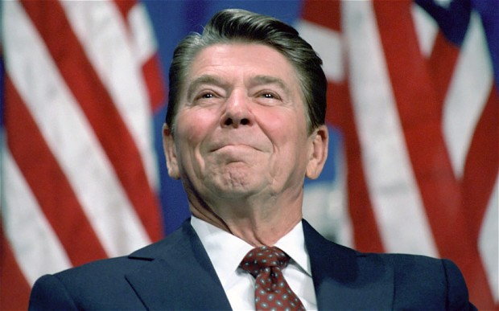
Ronald Reagan

Slide 19
The Resurgence of Western Europe
IV. The Diplomatic Context
The US insisted on partial rearmament of Germany and its participation in NATO
European Union
West Germany, France, Italy, Luxembourg, the Netherlands, and Belgium
Common Market
Lowered tariffs
Single common currency
Euro

Slide 20
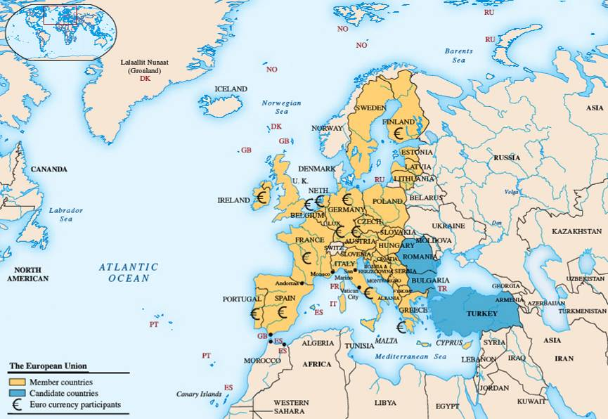

Slide 21
The Resurgence of Western Europe
V. Economic Expansion
Economic growth accompanied political and diplomatic change
Western European & North American agriculture production and productivity increased rapidly
More-so in North America
Consumer products sales increase
Cars and appliances

Slide 22
The Resurgence of Western Europe
Western Europe led in weapons exports with the US and the USSR trailing behind
Immigration to the US & Western Europe increased as high unemployment rates around the world rose
Some “guest workers” suffered low wages, segregation, discrimination, and racism
Lifestyles changed
Vacations
Shopping malls

Slide 23
Cold War Allies
The US, Canada, Australia, & New Zealand
Development in these areas paralleled those in Western Europe
I. Former Dominions
Canada
Welfare policies
French/English division
1982, a new Constitution is established
Gave provinces more of a voice in government

Slide 24
Cold War Allies
New Zealand & Australia
Join a mutual defense pact with the US in 1951
Directed at communist aggression
Both take part in the Korean War
Australia backs US in Vietnam
Both distance themselves from US Foreign Policy in the 1970’s
Most capital came from Japan and the US

Slide 25
Cold War Allies
II. The “US Century”?
The Defense Department & the CIA established in 1947
A policy of containment of communism and the Soviet Union was implemented in the 1950’s
Korean War
Vietnam Conflict
Cuban Missile Crisis
US Emerges as the world’s only Superpower

Slide 26
Culture and Society in the West
I. Social Structure
Economic growth eased some social conflicts
White-Collar sector expanded due to social mobility
Middle class grows
Unskilled work done mostly by immigrants
Expansion of consumerism

Slide 27
Culture and Society in the West
II. The Women’s Revolution
Starting in the 1950’s women began to have:
Job opportunities
Mostly clerical jobs
Less pay than men
More Education
Access to divorce
Reproductive rights
Abortion
Birth control
Less children being born
New Feminism
More equality for women

Slide 28
Culture and Society in the West
III. Western Culture
“Brain Drain” from Europe to the US
Scientific Advancements
Discovery of DNA
Nuclear Research
Space research
Pop Art
Picasso
Warhol

Slide 29
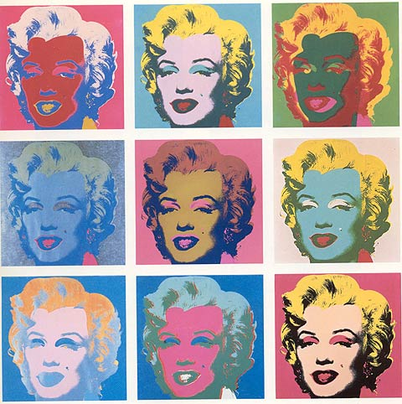
Warhol

Slide 30
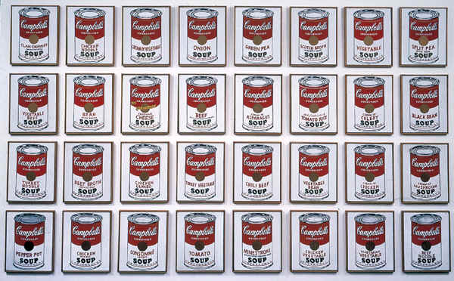
Warhol

Slide 31
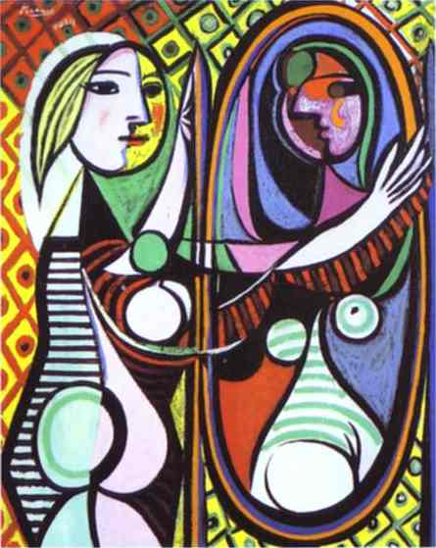
Picasso

Slide 32
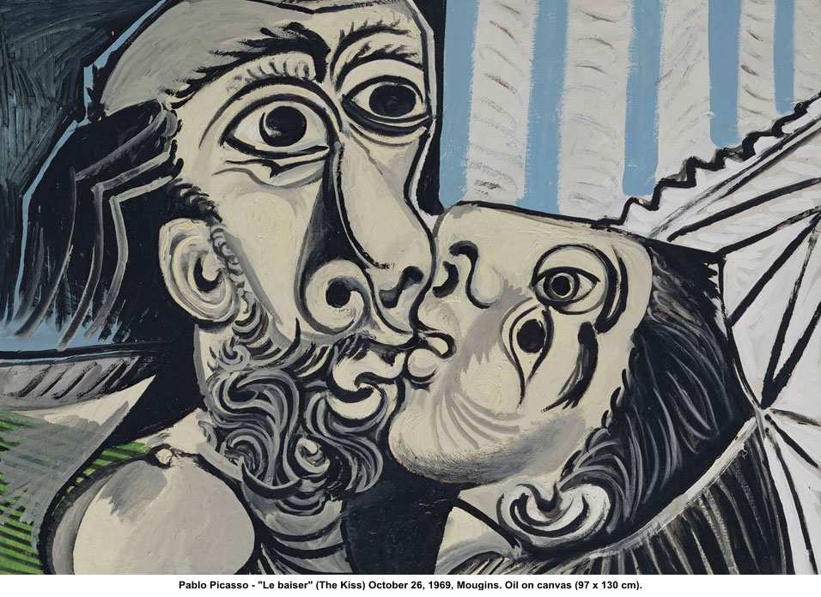
Picasso

Slide 33
Culture & Society in the West
IV. A Lively Pop Culture (popular culture)
Coca-colaization
Blue jeans
Bubble gum
TV shows
Music
The Beatles
Punk scene
Sexual culture
Relaxation of sexual standards

Slide 34
Eastern Europe After WWII: A Soviet Empire
I. The Soviet Union as a Superpower
Expansion
Pacific Islands and North Korea
Concentration on industry and weapons development
Atomic and hydrogen bombs
Missiles
Naval forces
Alliances and links to communist movements worldwide
China, Vietnam, & Cuba

Slide 35
Eastern Europe After WWII: A Soviet Empire
II. The New Soviet Empire in Eastern Europe
The USSR dominated all of Eastern Europe except Greece, Yugoslavia, and Albania
Attacked the Catholic Church
Collectivization
5-Year Plans
Industrialization

Slide 36
Eastern Europe After WWII: A Soviet Empire
East German workers protest in 1953
Repressed by Soviet troops
Built the Berlin Wall in 1961
Stalin dies in 1956
Hungary
Sets up a moderate regime
Independent of the Soviets
New regime crushed by the Soviet army

Slide 37
Eastern Europe After WWII: A Soviet Empire
Czechoslovakia
Liberal regime
Suppressed by the Soviets in 1963
Poland
Solidarity Movement challenges control by USSR
Polish army takes control of the state

Slide 38
Eastern Europe After WWII: A Soviet Empire
III. Evolution of Domestic Policies
Nationalism used to appeal to communist loyalty
US seen as an “Evil” power
Soviets fear war with US and agree to strong government control
Cultural isolation
Strict limits on travel, media, and contact with foreigners or foreign ideas

Slide 39
Soviet Culture
The Soviet regime declared war on the Orthodox Church & other religions
Church under tight government control
Mostly the elderly minority remained loyal to the church
Jews restricted – anti-Semitism
Soviets attack Western styles & dictates art
Alexander Sozhenitsyn (writer) exiled to US for writings on Siberian prisons

Slide 40
Soviet Culture
Soviet culture emphasized science and social science
Fundamental discoveries in physics, chemistry, and math
I. Economy & Society
Industrialized by the 1950’s
State control of all economic sectors
Little emphasis on consumer goods
Allowed the society to remain poor

Slide 41
Soviet Culture
Soviet industrialization caused a lot of environmental damage
Led to health damages to the people in affected areas
Issues with food supplies due to capital going to armaments rather than agriculture
Sports programs were extensive & sponsored by the state
Several Olympic victories
Communist party members had a higher standard of living than the masses

Slide 42
Soviet Culture
II. De-Stalinization
Stalin dies in 1956
A committee ruled after his death until Nikita Khrushchev gained power in 1956
Khrushchev attacked Stalinism
Cuban Missile Crisis, 1962
Space programs – Sputnik 1957

Slide 43
Soviet Culture
USSR experienced conflicts with Communist China
Muslim resistance
Growing number of Muslims in the USSR
Invasion of Afghanistan in 1979
USSR never engaged in direct warfare, but maintained a high level of preparedness

