Slide 1
The World Between Wars: Revolutions, Depressions, & Authoritarian Response

Slide 2
The Roaring Twenties
In the West consumerism and changes in women’s roles gained ground
The US and Japan have economic gains
New Authoritarian movements surface in Eastern Europe and Italy

Slide 3
The Roaring Twenties
I. Bouncing Back
Massive war deaths
Over 10 million Europeans died
Many wounded
Property damage
Economic downfall
Postwar inflation
Wipeout of savings

Slide 4
The Roaring Twenties
Germany
Becomes a democratic republic (Weimer Republic)
Hapsburg & German Empire end
Still paying war reparations (cost of WWI)
Kellogg-Briand Pact
Countries agree to never to war again

Slide 6
The Roaring Twenties
Cubist movement
Picasso
Renders familiar objects geometrically
Scientific advancement
Einstein’s theories of relativity
Genetics
Atomic structure

Slide 7
The Roaring Twenties
Mass consumerism
Women gained freedoms
Smoking
Dancing in nightclubs
Suffrage (the right to vote)
Key economic sectors
Agriculture
Coal mining
Neither recovered prosperity

Slide 8
Flapper’s in the 20’s

Slide 9
The Roaring Twenties
Western Europe loses exports to the US and Japan
Most European countries faced political extremism
Communism
Fascism

Slide 10
The Roaring Twenties
II. Other Industrial Centers
Canada, Australia, and New Zealand
Become independent nations
British Commonwealth of Nations

Slide 11
The Roaring Twenties
The United States
Economic boom
Ford introduces the assembly line in 1913
Cultural exports
Jazz spreads in African American centers
Hollywood becomes global

Slide 12
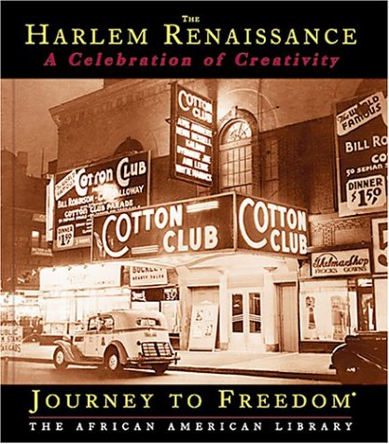
Harlem Renaissance

Slide 13
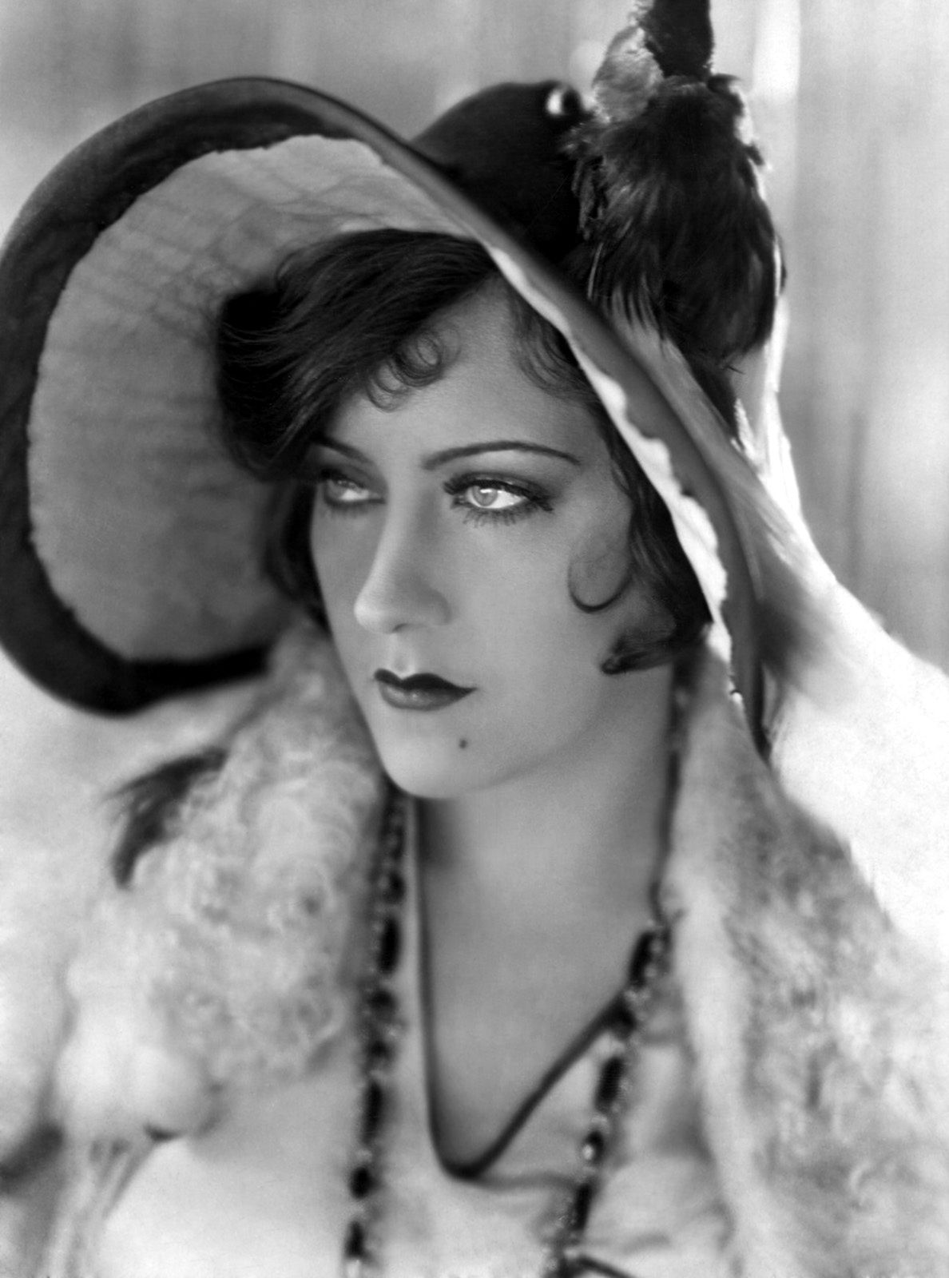
Hollywood 1920’s

Slide 14
The Roaring Twenties
The US Senate
Rejects the Versailles treaty
Refuses to enter the League of Nations
Adopted isolationism after WWI
“Red Scare”
Fear of communism

Slide 15
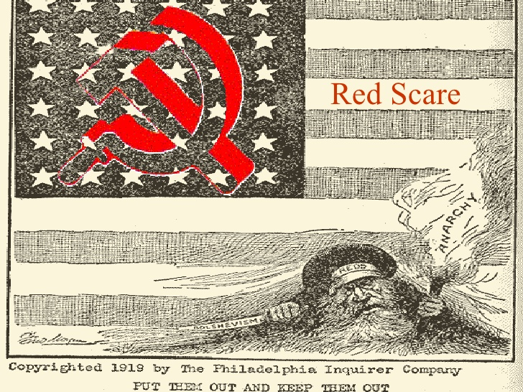

Slide 16
The Roaring Twenties
Japan
Industrializes
Agricultural improvements
Economy dependent on cheap exports to the West
Rapid population growth
Strong military buildup

Slide 17
The Roaring Twenties
III. New Authoritarianism: The Rise of Fascism
Hostility to liberal and democratic political systems emerge in western Europe
Benito Mussolini
Forms fascio di comattimento or “union for struggle”
Replaces socialism and capitalism
Fascism
Authoritarian leadership devoted to nationalists values

Slide 18
Mussolini

Slide 19
The Roaring Twenties
Conditions Post WWI in Italy
Nationalists resent little gains received after the war
Veterans felt abandoned by civilian society
Labor unrest increased
Inept (inefficient) parliament
In 1922 the Italian king calls on Mussolini to form a new government
Elections suspended in 1926

Slide 20
The Roaring Twenties
IV. The New Nations of Eastern Central Europe
Authoritarian governments dominate
Most countries started with western style parliaments, but couldn’t maintain them
Most become dictatorships or monarchs with absolute power
Causes social tensions
Nationalism prevalent
Bitter rivalries among small states
Most eastern European nations were agricultural and depended on sales to western Europe

Slide 21
The Roaring Twenties
V. A Balance Sheet
Representative Governments
Germany, Japan, Canada
Social change
Economic prosperity
Democracy challenged
Eastern Europe & Italy
America and Japan become economic powers

Slide 22
Revolution: The First Waves
Major revolutions breakout in Mexico, Russia, and China before or during WWI
All three revolutions reflect challenges to Western domination
Concerns about world economy
Syndication
Economic and political system based on organized labor

Slide 23
Revolution: The First Waves
I. Mexico’s Upheaval
Mexican Revolution
10 year civil war
Eventually influenced by WWI
Affects exports
Reliance on outside supplies
Foreign control – US owns 20% of national territory
Porfirio Diaz
In power since 1876
Dictator
Corrupt political system benefits elites
Hacienda system
Censorship of complaints

Slide 24
Porfirio Diaz

Slide 25
Revolution: The First Waves
Francisco Madero
Ran against Diaz in 1910
Arrested & Diaz stays in control
Calls for revolt upon his release from prison
Rebellion
Pancho Villa, Madero, Emiliano Zapata
Leaders
Diaz removed from power
Madero assassinated in 1913 by a military coup

Slide 26
Francisco Madero

Slide 27
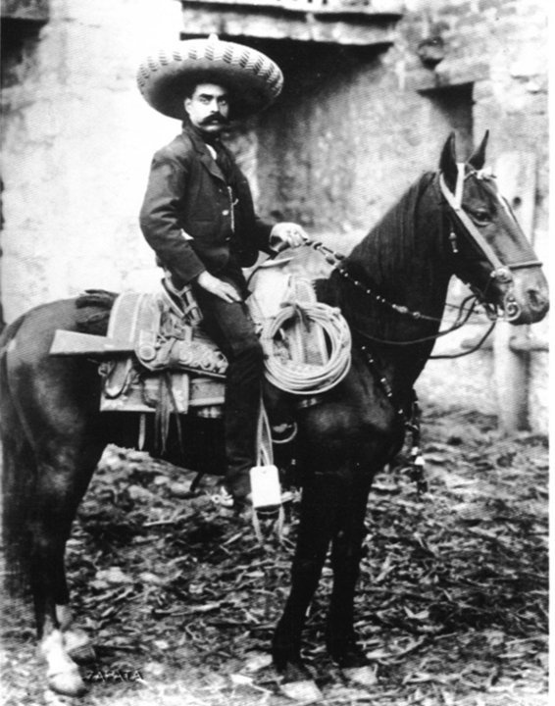
Pancho Villa & Emiliano Zapata

Slide 28
Revolution: The First Waves
Victoriano Huerta
Imposes a Diaz-type dictatorship
Supported by landowners, the army, and foreign companies
Villa & Zapata rise against Huerta
Huerta forced from power in 1914
Villa and Zapata fight over leadership and how to run the new regime

Slide 29
Revolution: The First Waves
General Alvaro Obregon
Becomes first elected President of Mexico when civil war ends in 1920
Mexican Constitution of 1917
Promises land reform
Limited foreign ownership of resources
Gives workers rights
Restricts church power
Educational reforms

Slide 30
Revolution: The First Waves
President Lazaro Cardenas (1934-1940)
Land redistribution
40 million acres given as ejidos (communal holdings)
Expands education

Slide 31
Revolution: The First Waves
II. Culture and Politics in Postrevolutionary Mexico
Nationalism and Indigenism
Indianization of art
Diego Rivera
Jose Clemente Orozco
Opposition of revolutionary gains
Marxist socialism by intellectuals
Secularization opposed by Catholic Church
Cristeros
Peasant movement backed by the church and conservatives

Slide 32
Revolution: The First Waves
The United States intervenes during the revolution
Desire to maintain order
Fear of German influence
Economic interests
PRI (Party of Institutionalized Revolution) arises in the 1920’s
Controlled politics

Slide 33
Revolution: The First Waves
III. Revolution in Russia: Liberalism to Communism
Revolution breaks out in St. Petersburg in 1917
Food riots
Strikes
Wanted a new political regime
The soviet (a council of workers) take over the city
Tsar abdicates the throne (resigned as king)

Slide 34
Revolution: The First Waves
Alexander Kerensky
Liberal Russian Revolutionary leader
November 1917
Bolsheviks (Communists) take over
Led by Vladimir Lenin
Closes Parliament
Forms a Congress of Soviets
Stayed in control until 1989
1918-1921
The Western World reacts to Russia’s civil war
Anti-Communism

Slide 35
Vladimir Lenin

Slide 36
Revolution: The First Waves
IV. Stabilization of Russia’s Communist Regime
Red Army (Russian Army)
Led by Leon Trotsky
Used able generals and loyal masses
Lenin’s New Economic Policy
1921
State set basic economic policies
Union of Soviet Socialist Republics (USSR) formed in 1923
Bolshevik revolution a success
Moscow becomes the new capital
New constitution

Slide 37
Leon Trotsky

Slide 38
Revolution: The First Waves
The Supreme Soviet
Parliament
Elections held
Competition in elections prohibited
Communists have a monopoly over power
Communists reestablish an authoritarian system

Slide 39
Revolution: The First Waves
V. Soviet Experimentation
Gains for workers & women
Education expands
Focus on Communism and science
Lenin dies in 1924
St. Petersburg renamed Leningrad
Succeeded by Joseph Stalin

Slide 40
Joseph Stalin

Slide 41
Revolution: The First Waves
Stalin sets up Collectivization
Attacks peasant landownership
State controls farmland
Not as efficient
Comintern established to promote Communism outside of Europe

Slide 42
Revolution: The First Waves
VI. Toward Revolution in China
The last Qing emperor abdicates in 1912
Yuan Shikai
Military commander who hoped to seize the vacated throne & establish a new dynasty
Japan invades
Major factor in China until 1945
Western powers compete to profit from China’s divisions and weaknesses

Slide 43
Revolution: The First Waves
Internal divisions and foreign influences paved the way for the victory of the Chinese Communist Party
Led by Mao Zedong

Slide 44
Mao Zedong

Slide 45
Revolution: The First Waves
VIII. China’s May Fourth Movement and the Rise of the Marxist Alternative
Sun Yat-sen
Heads the Revolutionary Alliance
Leads revolt
Elected President in 1911
Establishes a western-like Parliament
Resigns in 1912
Yuan Shikai becomes president

Slide 46
Revolution: The First Waves
Yuan Shikai
Used military power to put down opposition
Schemes to become next emperor foiled by:
Rival warlords
Republican nationalists
Japan

Slide 47
Yuan Shikai

Slide 48
Revolution: The First Waves
Japan
Twenty-One Demands
Would reduce China to a protectorate
Yuan refuses
Forced to resign presidency in 1916
Control of China confirmed by Treaty of Versailles
May Fourth movement
Aimed at forming China into a liberal democracy
Western Reform
Mass demonstrations protesting against Japan

Slide 49
Revolution: The First Waves
The Bolshevik victory and programs launched to rebuild Russia prompt Chinese intellectuals to consider the works of socialist thinkers
Marx, Lenin, Engels, Trotsky
Li Dazhao
Marxism adapted to fit China
Saw peasant, rather than urban workers, as the vanguard of revolutionary change
Influences Mao Zedong

Slide 50
Li Dazhoa

Slide 51
Revolution: The First Waves
Mao Zedong
Leads the Communist Party of China in 1921
Attacks imperialist powers
Wanted a government committed to social reform and social welfare
Similar to Confucianism

Slide 52
Revolution: The First Waves
IX. The Seizure of Power By China’s Guomindang
Guomindang – Nationalist Party
Put together by Sun Yat-sen 1919
Allies with Communists
Supported by the Soviet Union
Wampoa Military Academy
Chiang Kai-shek – head of academy and Nationalist leader
Political tensions distract Nationalist leaders from the economic downfall
Famine and disease prevalent

Slide 53
Chiang Kai-shek

Slide 54
Revolution: The First Waves
X. Mao and the Peasant Option
Chaing Kai-shek
Leader of Nationalists
Seizes power after Yat-sen dies
Attacks Communists
Massacre in Shanghai 1927
Workers killed
Mao Zedong
Long March of 1934
Solidifies Mao’s leadership of the Communist Party

