Slide 1
Attempts at Peace after WW I
Treaty of Versailles – an attempt to make a
lasting peace after World War I.
It failed to keep the peace
a. Too harsh, attempted to punish Germany,
planted the seeds for a future war
b. Germany and her allies had been treated
unfairly and would seek revenge
c. Allies did not enforce it

Slide 2
2. The League of Nations – world organization to keep peace
a. Eliminate causes of war
b. Prevent war by disarmament and solve disputes in a peaceful way
The League of Nations failed to keep the peace
a. U.S. did not join due to their isolationist policy after WWI
b.no army or other way to enforce decisions

Slide 3
3. Washington Conference (1921-22) – attempted to limit the building of warships, eventually failed because the Japanese ignored it and continued to build warships
4. Locarno Pact (1925) – Germany and France agreed that they would never go to war again.
Failed because Hitler ignored it when he came to power

Slide 4
5. Pact of Paris (1928) – most nations agreed to outlaw war as part of their foreign policy
Failed because -
Aggressor nations ignored it
Britain, France, and the U.S. would not fight to enforce it

Slide 5
1919 – 1939
1. The Treaty of Versailles failed to keep the peace after WW I, because the treaty was too harsh and set the stage for a new war
2. The Great Depression created economic conditions that caused many people to lose faith in Democracy

Slide 6
3. The harsh conditions imposed by the Treaty of Versailles after World War I and the Great Depression helped lay the foundation for the rise of fascism in Germany and other countries in Europe
Hitler and many Germans blamed Germany’s defeat on the new government, the Weimar Republic and the Jews

Slide 7
4. The rise of totalitarian governments in Germany, Italy, Russia, and Spain was largely the result of severe economic and social problems caused in Europe after World War I.
All of these newly created totalitarian governments controlled the people by censorship, mass arrests, and a secret police force to keep order and terrorize the people

Slide 8
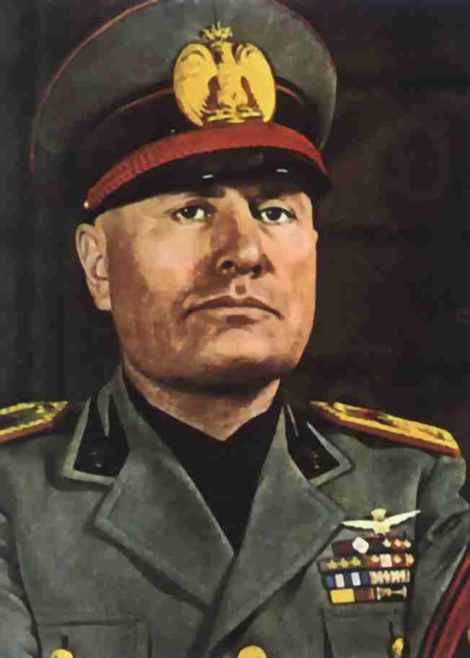
Mussolini M Mussolini

Slide 9
Mussolini
He came to power in Italy by promising to solve the country’s economic problems
Restore the old Roman Empire – make the Mediterranean Sea a Roman lake – “Mare Nostrum”

Slide 10
Adolf Adolph Hitler Hitler

Slide 11
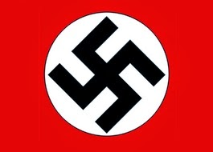
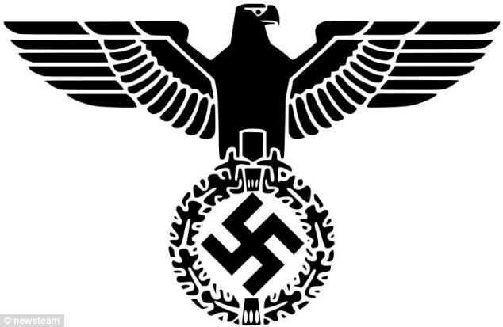
Hitler – his party was the Nazi Party (National Socialist Party)
He came to power by violence and intimidation.

Slide 12
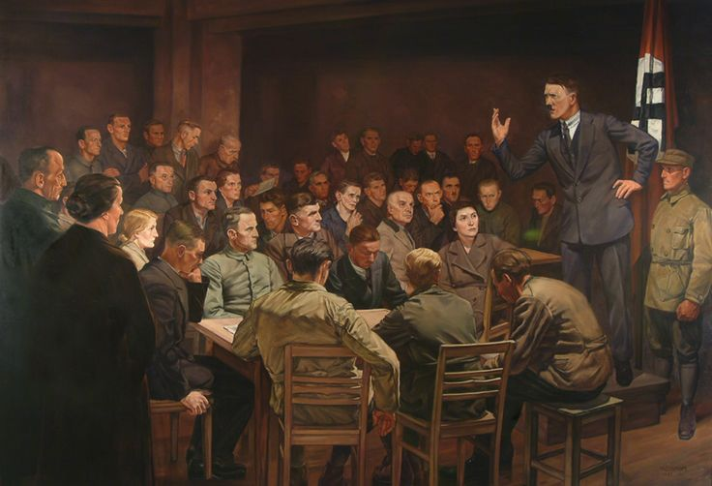
In 1922, he tried to overthrow the government of Munich. It failed and he was arrested, tried and sent to jail.

Slide 13
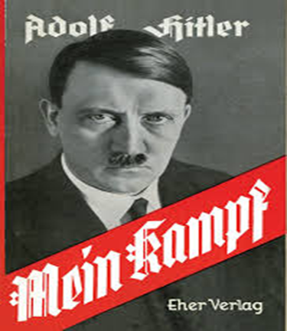
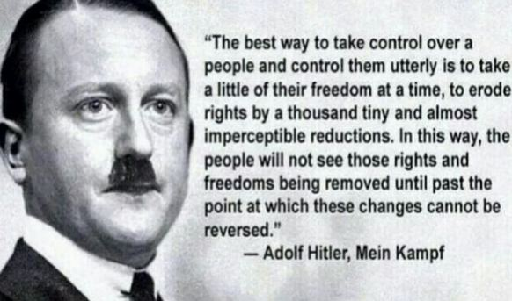
While in jail he wrote
“Mien Kampf” (My Struggle) – this outlined his plans for conquest.

Slide 15
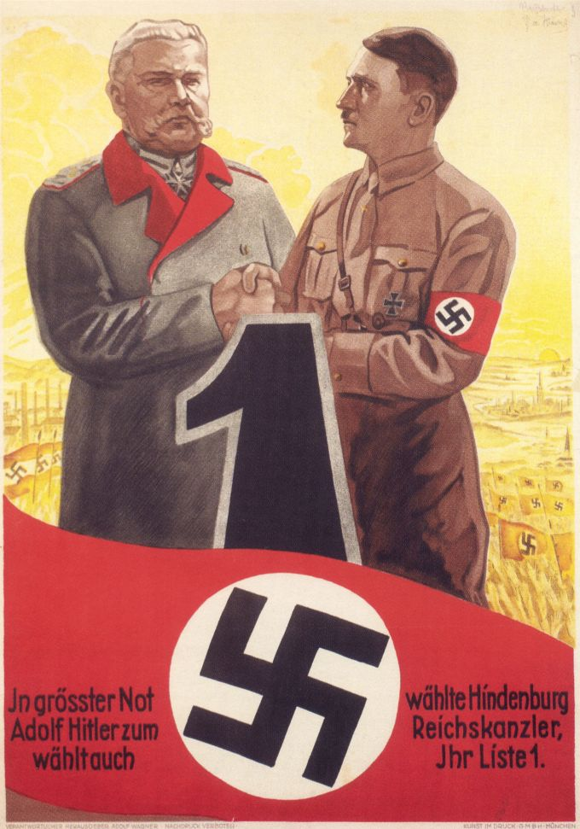
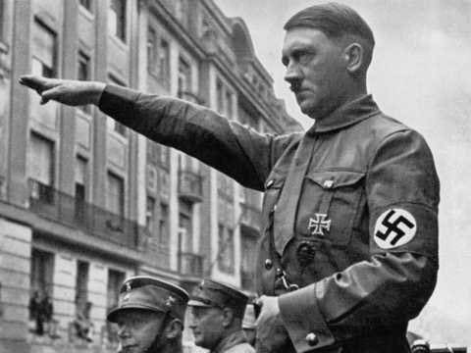
He ran for office and was appointed Chancellor.

Slide 16
Hitler used his office to pass the Enabling Act in 1933 – this gave him unlimited power for four (4) years.
Hitler ruled by decree – he made the laws not the legislature

Slide 17
“Night of the Long Knives”
Hitler’s political opponents taken out and shot

Slide 18
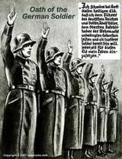
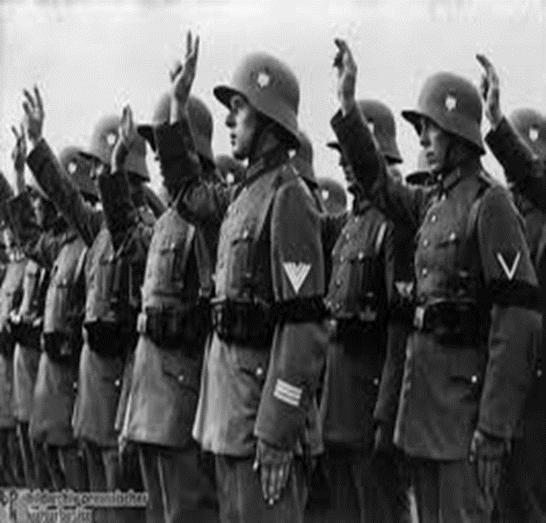
He used this to eliminate his opponents and had the army swear a direct oath of allegiance to him.

Slide 19
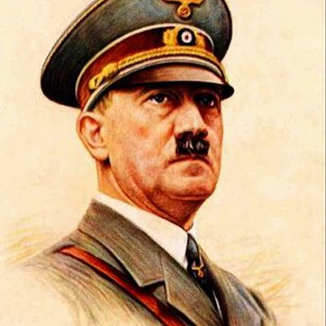
This gave him complete control and he was named Der Fuhrur – The Leader

Slide 20
5. These totalitarian government denied their people basic human rights - Kristallnacht and the Nuremburg Laws were examples of this in Germany
a. Nuremburg Laws – Laws passed by the Nazis to take civil rights from Jews
b. Kristallnacht – Nazi troops attacked Jewish homes, businesses, and synagogues

Slide 21
Fascist Aggression Leads to War Allies do not try to stop them
1. Germany, Italy and Japan committed actions of aggression, each claiming they needed to
Expand to solve their economic problems

Slide 22
a. Germany – Europe Hitler claimed Germany needed “Lebensraum” Living Space
b. Italy – Africa and the Balkans
c. Japan – Asia and the Pacific

Slide 23
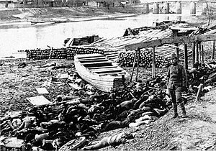
Japan invaded China in 1937, Nanjing and other cities were overrun by the Japanese
Thousands of captured Chinese soldiers, women, and children were taken out and shot by the Japanese

Slide 24
2. The British and French followed a policy of Appeasement to avoid war - giving into aggression to keep peace
a. 1938 – Britain and France allowed Hitler to take over Czech Sudetenland to avoid war – they thought Hitler would stop – Munich Agreement

Slide 27
b. March, 1939, Hitler took over all of Czechoslovakia – Britain and France pledged to support Poland if Hitler invaded

Slide 28
3. August, 1939, - The Non- Aggression Pact. Russia and Germany signed a treaty
2 parts
a. They agreed not to go to war against each other (public)
b. They would divide Poland – Kept Germany from fighting on two fronts
Led to war

Slide 29
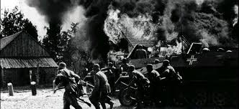
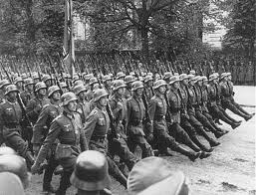
World War II 1939 - 1945
World War began on September 3, 1939, with the German invasion of Poland.

Slide 30
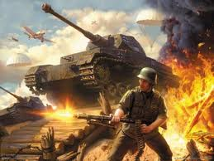
Blitzkrieg – lightning war – quick movement of troops

Slide 31
Sitzkrieg – Phony war – period of non fighting after the fall of Poland

Slide 32
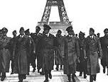
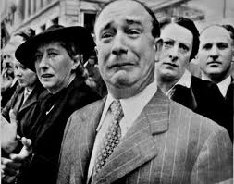
By July of 1940, most of Europe was under German control or influence only Britain remained free
Norway
Denmark
Belgium
France

Slide 33
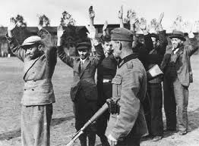
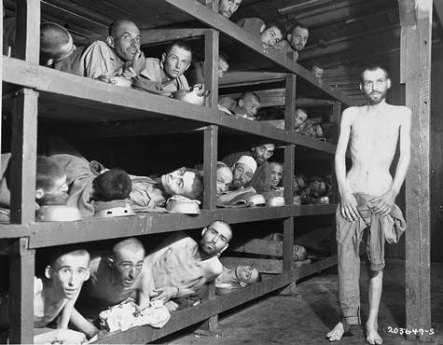
During this time the Germans launched their “Final Solution” to the Jewish problem
The Holocaust

Slide 34
June, 1941, Hitler invaded Russia hurt his cause for two reasons He was fighting a war on two fronts in Europe The Japanese became more aggressive in the Pacific

Slide 35
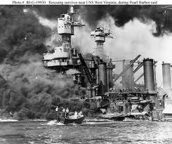
December 7, 1941 the Japanese Bombed Pearl Harbor The United States declared war

Slide 36
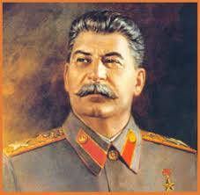
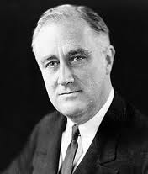
The Allies

Slide 37
The Allies
Neville Chamberlain - British Prime Minister, he believed that Hitler could be appeased and trusted to keep his word.
Winston Churchill - The British Prime Minister, He swore Britain would never surrender.

Slide 38
The Allies
Franklin Roosevelt (FDR) – U.S. President when WWII began
Harry Truman - American President, he made the decision to drop the atomic bombs on Japan.
Joseph Stalin - The leader of Communist Russia, his agreement with Hitler in 1939 paved the way for the invasion of Poland.

Slide 39
The Allies
Chiang Kai-Shek - The leader of nationalist China, fought against the Japanese
General Dwight Eisenhower - The Supreme Allied Commander, he planned the D-Day invasion of Europe in 1944.
D-Day was the storming of Normandy by the US forces

Slide 40
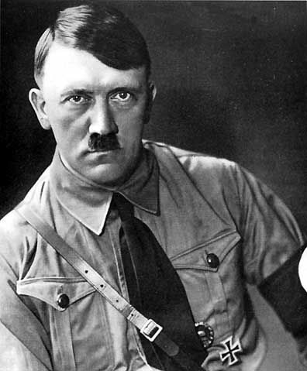
The Axis Powers

Slide 41
The Axis Powers
Mussolini - The Fascist leader of Italy, he came to power in 1922. He was a model for Hitler.
Hitler - The Nazi leader of Germany, his aggression in Europe led to war.

Slide 42
The Axis Powers
Hideki Tojo - The leader of the military dictatorship in Japan, his aggression in China and the Pacific led to war.
Rommel - The Desert Fox, the greatest of the German generals.

Slide 43
Two Battles started to turn the war in favor of the Allies
Stalingrad – Stopped the German invasion of Russia, Germans pushed back
Midway – The Japanese were stopped and pushed back in the Pacific

Slide 44
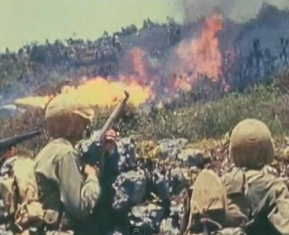
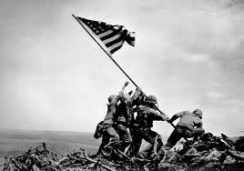
Pacific Front
U. S. used a strategy of
“Island Hopping”
Capturing only the most strategic Japanese bases and bypassing the rest working, their way to Japan

Slide 45
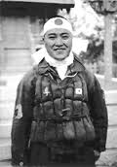
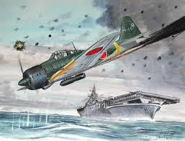
The Japanese response
Kamikaze Pilots committed suicide by crasing their planes into targets on Battleship Row

Slide 46
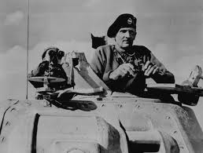
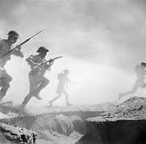
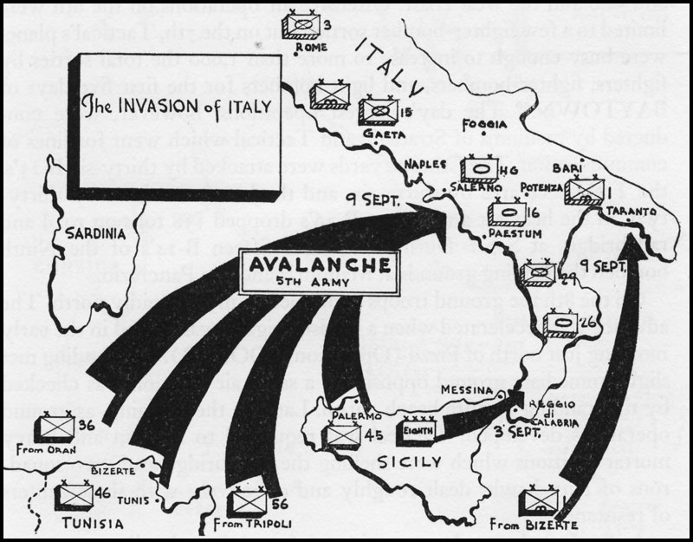
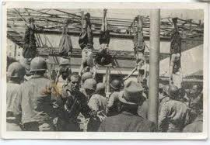
Africa and the European Front
The Germans and Italians were defeated in North Africa.
Southern Europe was invaded

Slide 47
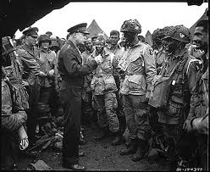
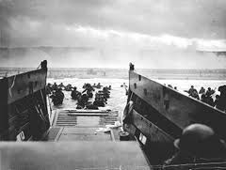
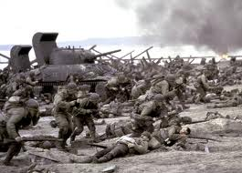
Western Europe
June 6, 1944, D-Day a second front in Europe was opened with the invasion of France

Slide 48
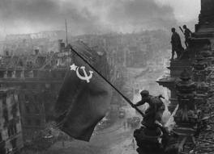
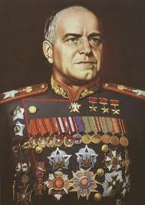
By May of 1945 the Allies had pushed into Germany from the East and West

Slide 49
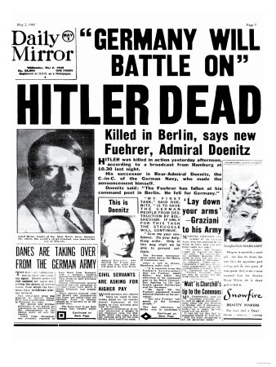
Hitler committed suicide to avoid being taken alive!

Slide 50
WWII
The United States dropped two atomic bombs on the Japanese cities of Hiroshima and Nagasaki.
The Japanese did not surrender until the US threatened to drop a third bomb on Tokyo.

Slide 51
August 1945 – Atomic Bomb dropped on the Japanese

Slide 52
The Marshall Plan
Plan created by the U.S. after the war.
The purpose of the plan was help all nations recover from the war and prevent future wars
Most of Western Europe was rebuilt under this plan

Slide 53
World War II Ended

