Slide 1
WWI

Slide 2
Five (5) Main Causes of World War I
Militarism
Alliances
a) Triple Alliance – Germany, Italy, and Austria- Hungary
b) Triple Entente – Britain, France, and Russia
Imperialism
Industrialism – New technology
Nationalism – Otto von Bismarck used nationalism and war to unify Germany

Slide 3
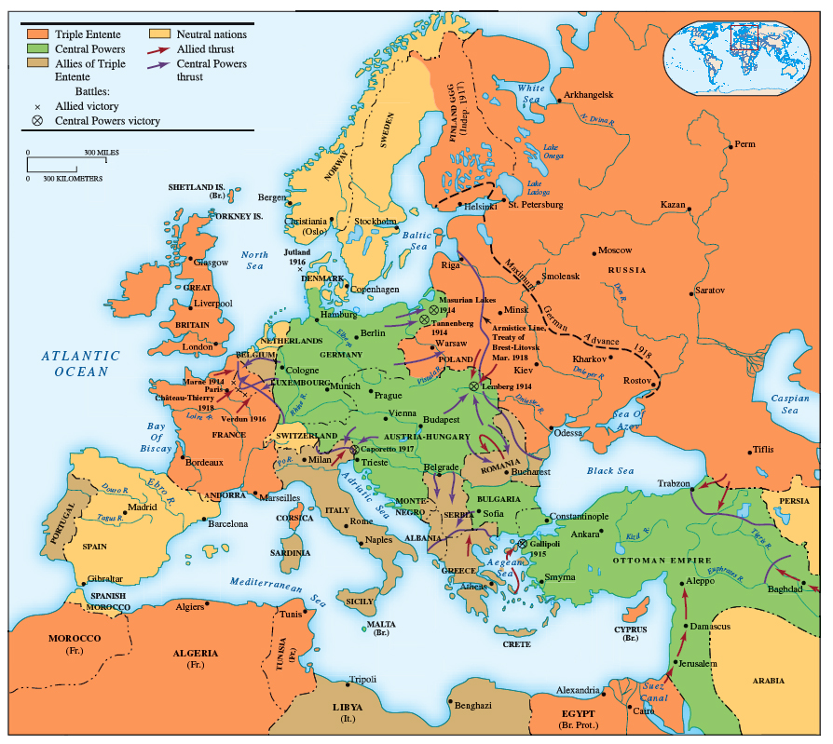

Slide 4
WWI
The Spark that triggered off the war was the assassination of the Archduke of Austria in the Balkans
***The Balkans were known as the Powder Keg of Europe because of nationalistic and imperialistic rivalries***
- Germany gave a “Blank Check” – assurance of support for Austria-Hungary against Serbia
- Austria declared war on Serbia, Russia declared war on Austria
- Germany declared war on Russia
- Germany launched the Schlieffen Plan – to end the war quickly by attacking France through neutral Belgium, then concentrate on Russia
- August, 1914 WWI began when Germany invaded Belgium

Slide 5
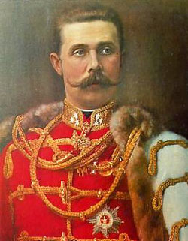
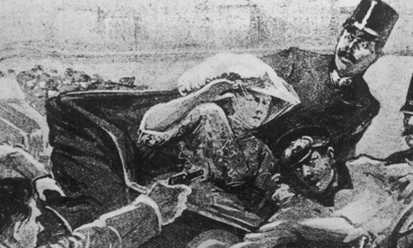
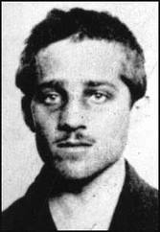

Slide 6
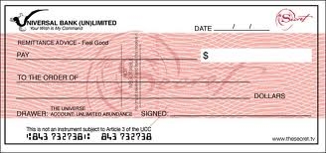
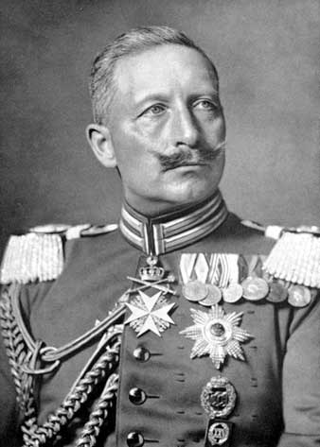

Slide 7
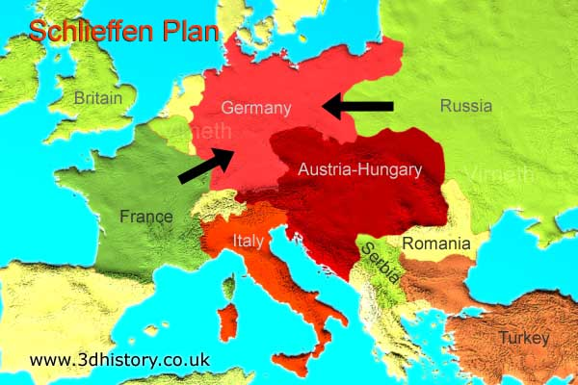
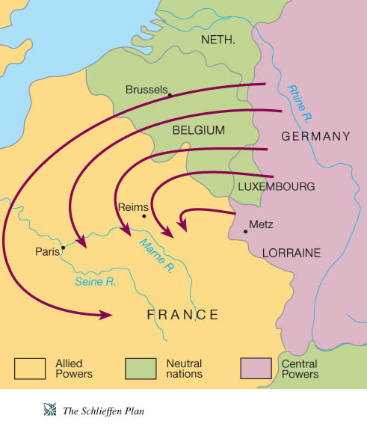

Slide 8
WWI
WW I was an industrial war because of new technology
New weapons were used – Technology led to high casualties
a) Machine gun e) Tanks
b) Poison gas f) Submarine (U-Boat)
Airplanes g) Flame throwers
d) Long range artillery h) Dreadnaught (battleships)

Slide 9
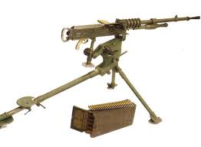
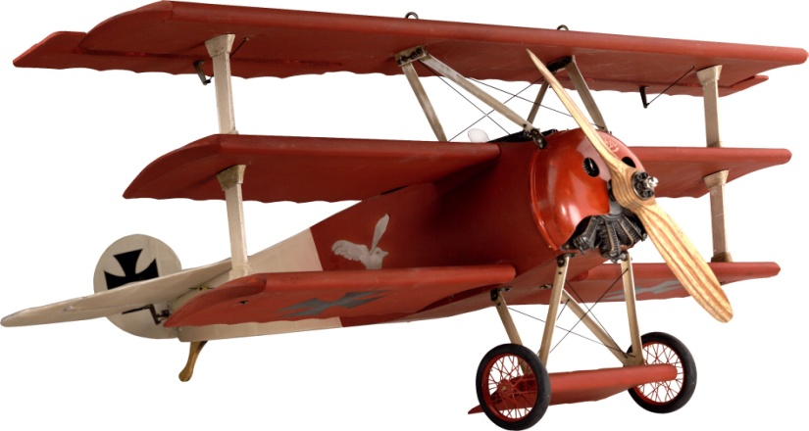
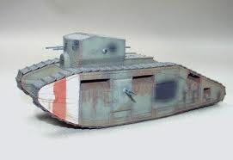
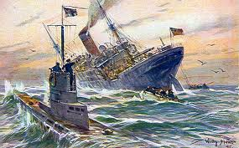
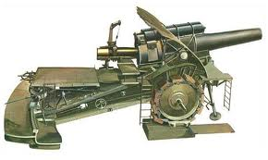

Slide 10
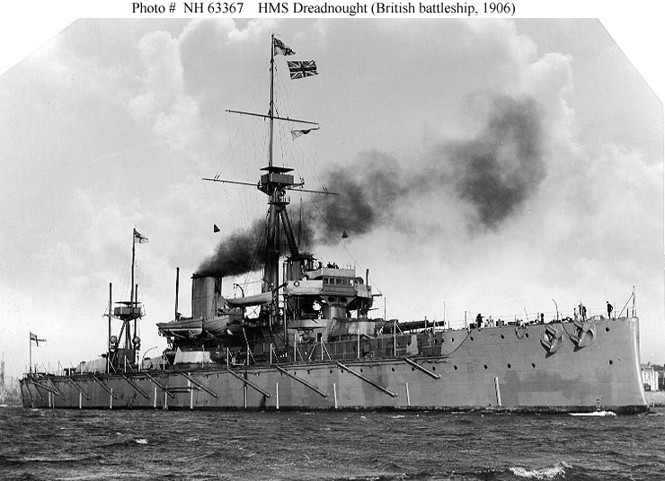

Slide 11
WWI
The war was fought on 3 main fronts – a front is where the battle line is formed
1) The Eastern Front – the Germans easily defeated the Russians
Russia continued to fight until 1918
In 1918, the Russians surrendered
2) The Western Front
The war bogged down to trench warfare (soldiers lived in trenches) – The war became a war of attrition – One side tries to outlast the other
By 1917, the Western Front was still a stalemate (neither side was winning)

Slide 12
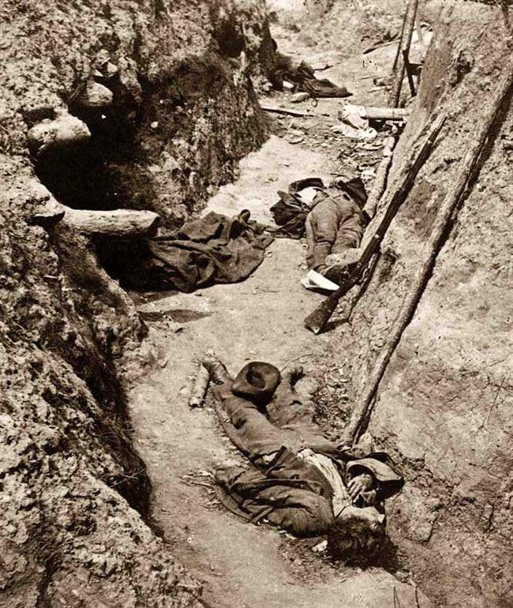
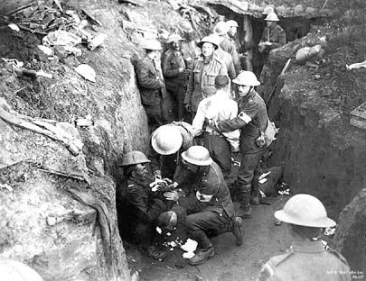
Trench Warfare

Slide 13
WWI
3) The war at sea
Great sea battles between surface ships were relatively rare during the war
Submarines and mines were a cheap and effective way to threaten battleships
Both sides attempted to cut off trade
The Germans used U-boats (submarines) to cut off Allied trade - unrestricted Submarine warfare – Sink any ship in British waters without warning
Convoys eventually proved to be the most effective defense against submarines

Slide 14
WWI
In 1915, The Lusitania a civilian passenger ship was torpedoed by a German U-boat
The U.S. threatened war – The Germans agreed to restrict their attacks to warships

Slide 15
WWI
The U.S. entered the war in April, 1917
Three main causes:
British propaganda (information designed to influence people’s beliefs or actions)
German unrestrictive submarine warfare (Sinking of the Lusitania)
The Zimmermann Telegram (Note) – The Germans attempted to get Mexico to declare war on the United States

Slide 16
WWI
The end of the war
2) After the Russians surrendered, the Germans launched one last major offensive. The offensive failed – The Germans were pushed out of France during the Battle of Argonne Forest
3) Nov. 11, 1918, the Germans agreed to stop fighting – The Armistice was signed – WWI ended

Slide 17
WWI
The Paris Peace Conference – The Treaty of Versailles
The Results of WW I
Millions of soldiers and civilians died as a result of the war
The war cost over $350 billion
International trade suffered this helped lead to a worldwide depression – European treasuries were drained
9 new countries were created – This led to new subject nationalities
3 major European dynasties were overthrown
German power was weakened
The League of Nations was created
*The conditions that grew out of WW I led to the rise of a new form of one man rule – Fascism*

Slide 18
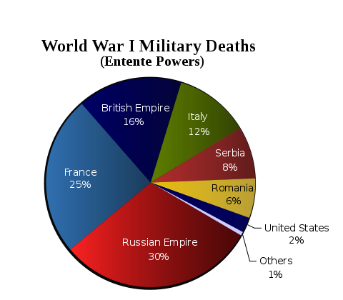
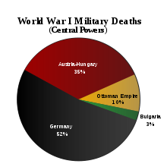

Slide 19
WWI
The Peace Conference
The Allies met in Paris to make peace – Many believed decisions would be based on Woodrow Wilson’s plan for peace – The 14 Points
5 main parts of the 14 Points
Self-determination of submerged nationalities
Disarmament and no secret treaties
Fair treatment of colonial people
Creation of a League of Nations – An organization created to keep peace through cooperation and negotiation
“Peace without victory” all nations would be treated fairly

Slide 20
WWI
Views of why the Treaty of Versailles failed to keep the peace
It was too harsh, it planted the seeds for future war.
Germany and her allies had been treated unfairly and would seek revenge
It left a legacy of bitterness and hatred in the German people

